Slide 1

ECE 802, Electric Motor Control
Synchrophasors

Slide 2
History and Application
History
Symmetrical component distance relay introduced in the 1970s
Phasor measurement unit (PMU) introduced in the 1980s by Virginia Tech researchers
PMUs were manufactured by Macrodyne in the 19990s
Today, PMU capability is being built in to many power system components
Goals: Achieve real-time state estimation (situational awareness) of the power system leading to better control and stability
Applications
Visualization of dynamic system response
System wide disturbance recording
Determining stability margins
Wide area control
Optimization and automation
Generator synchronizing and control

Slide 3
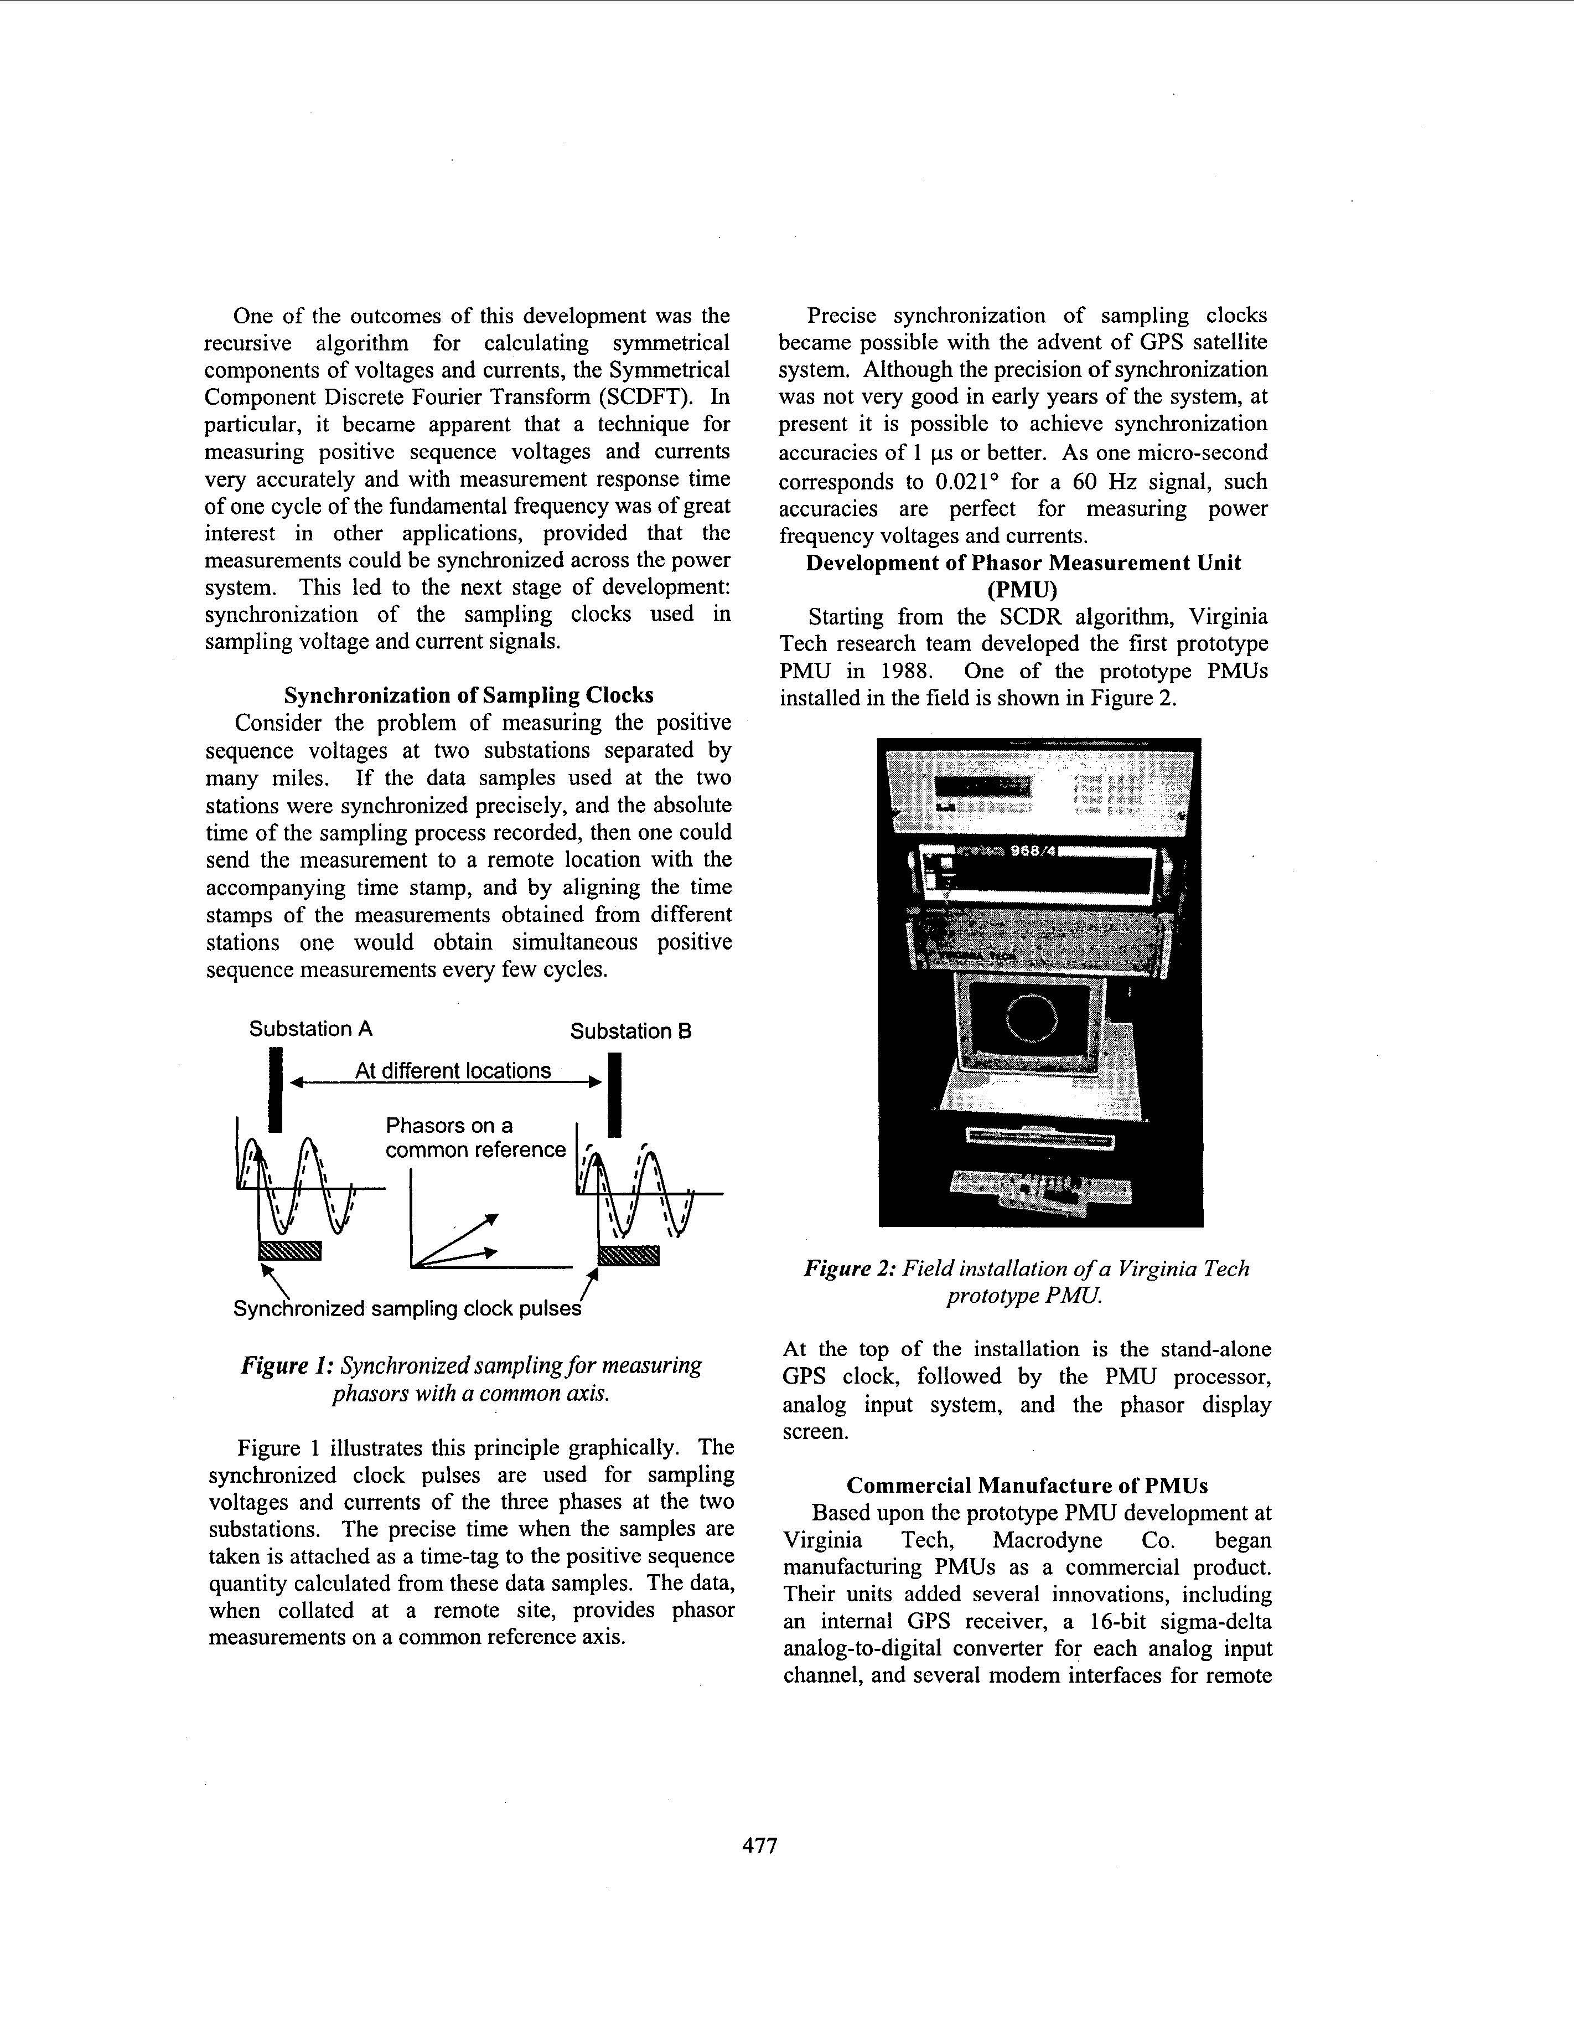
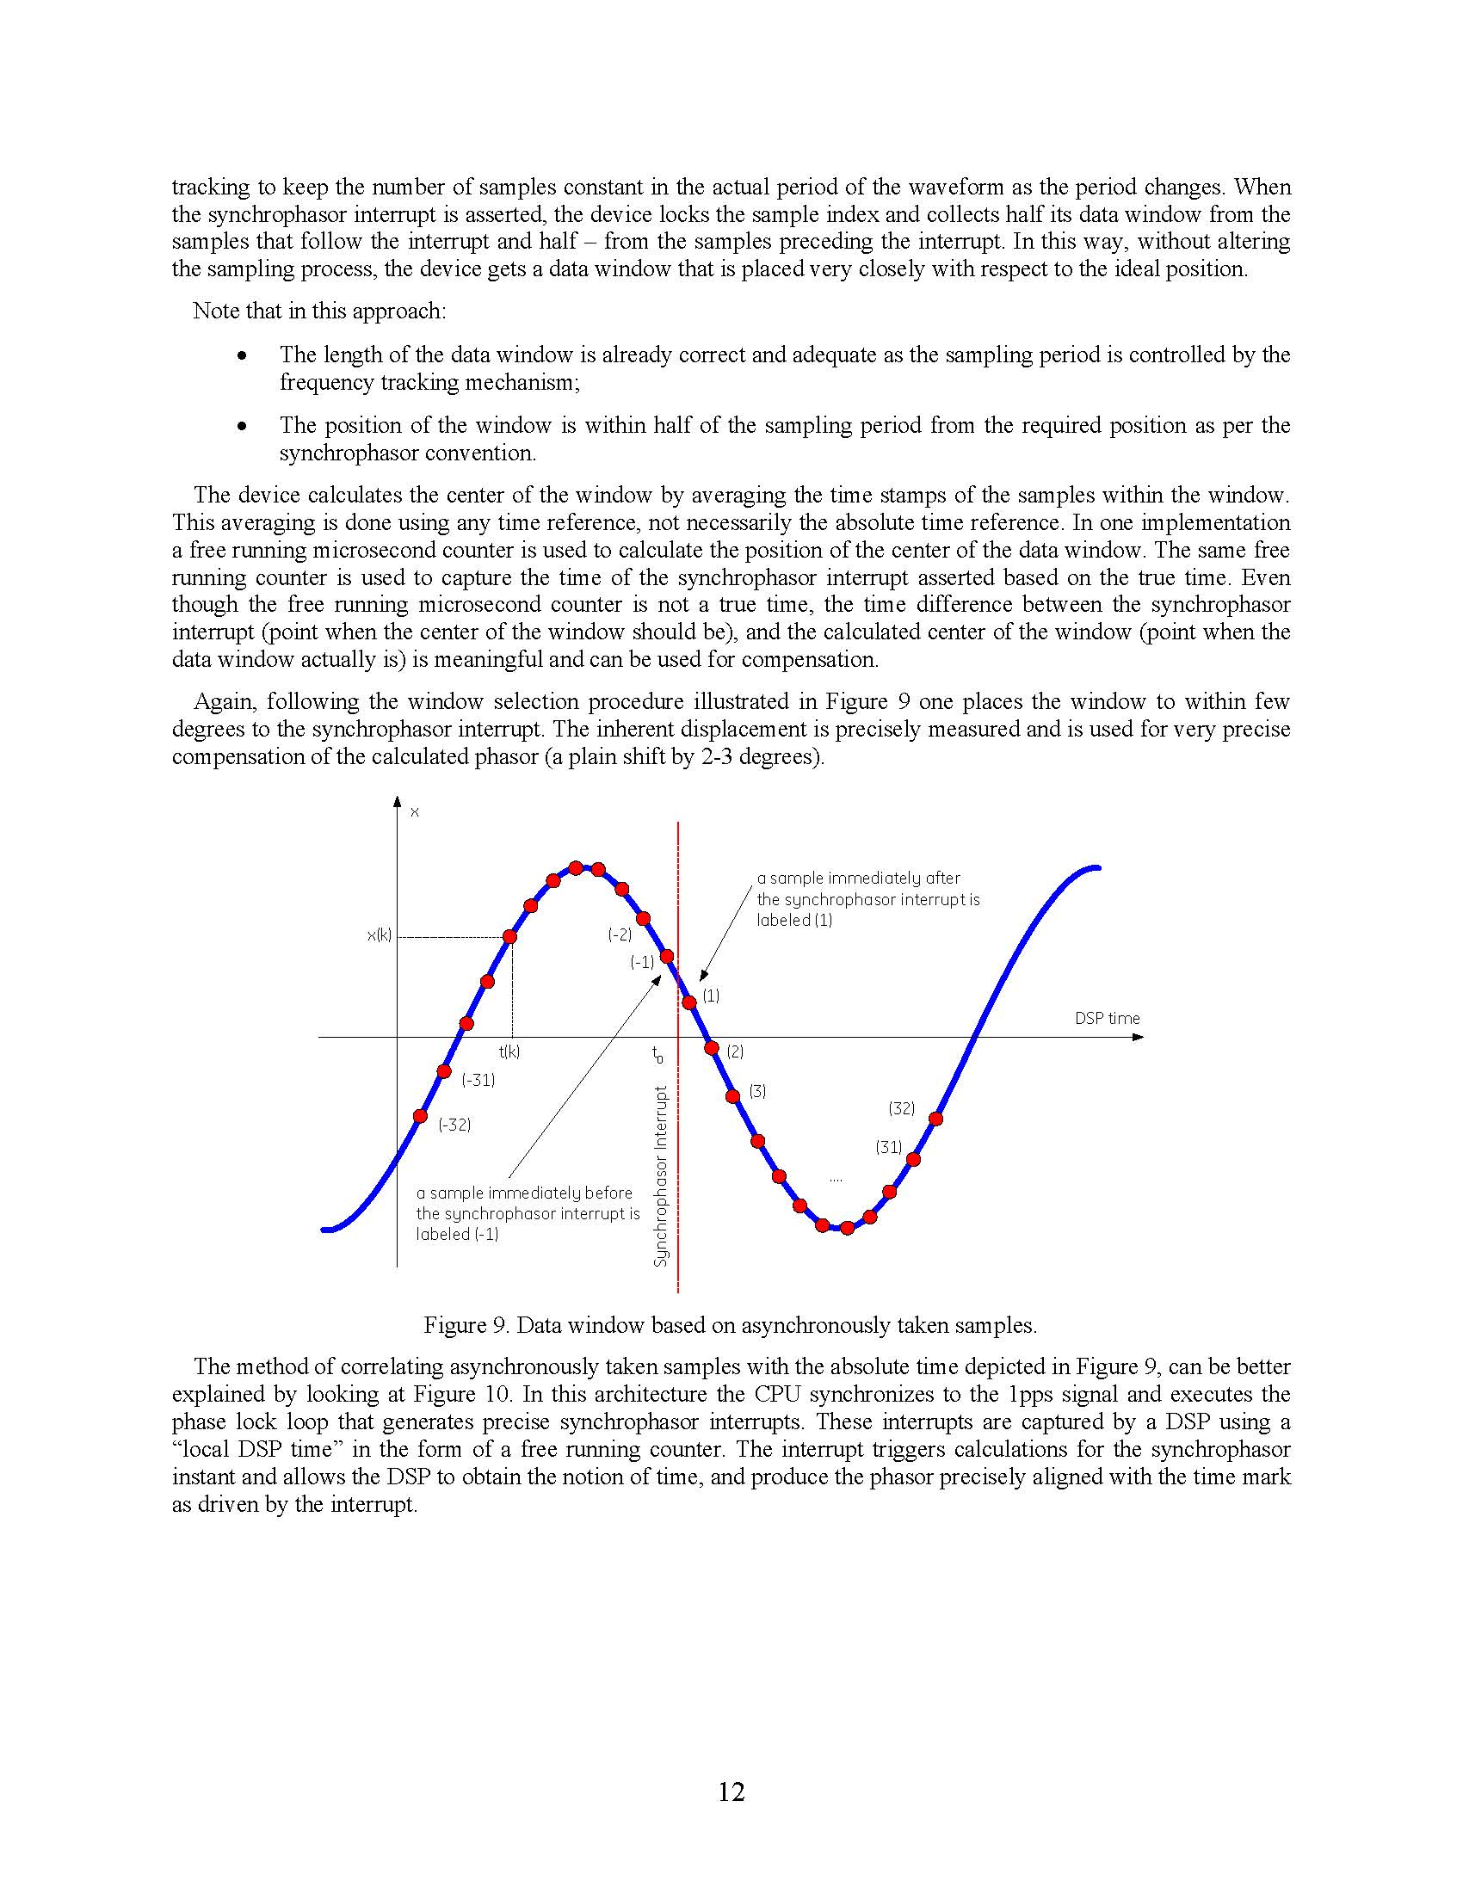
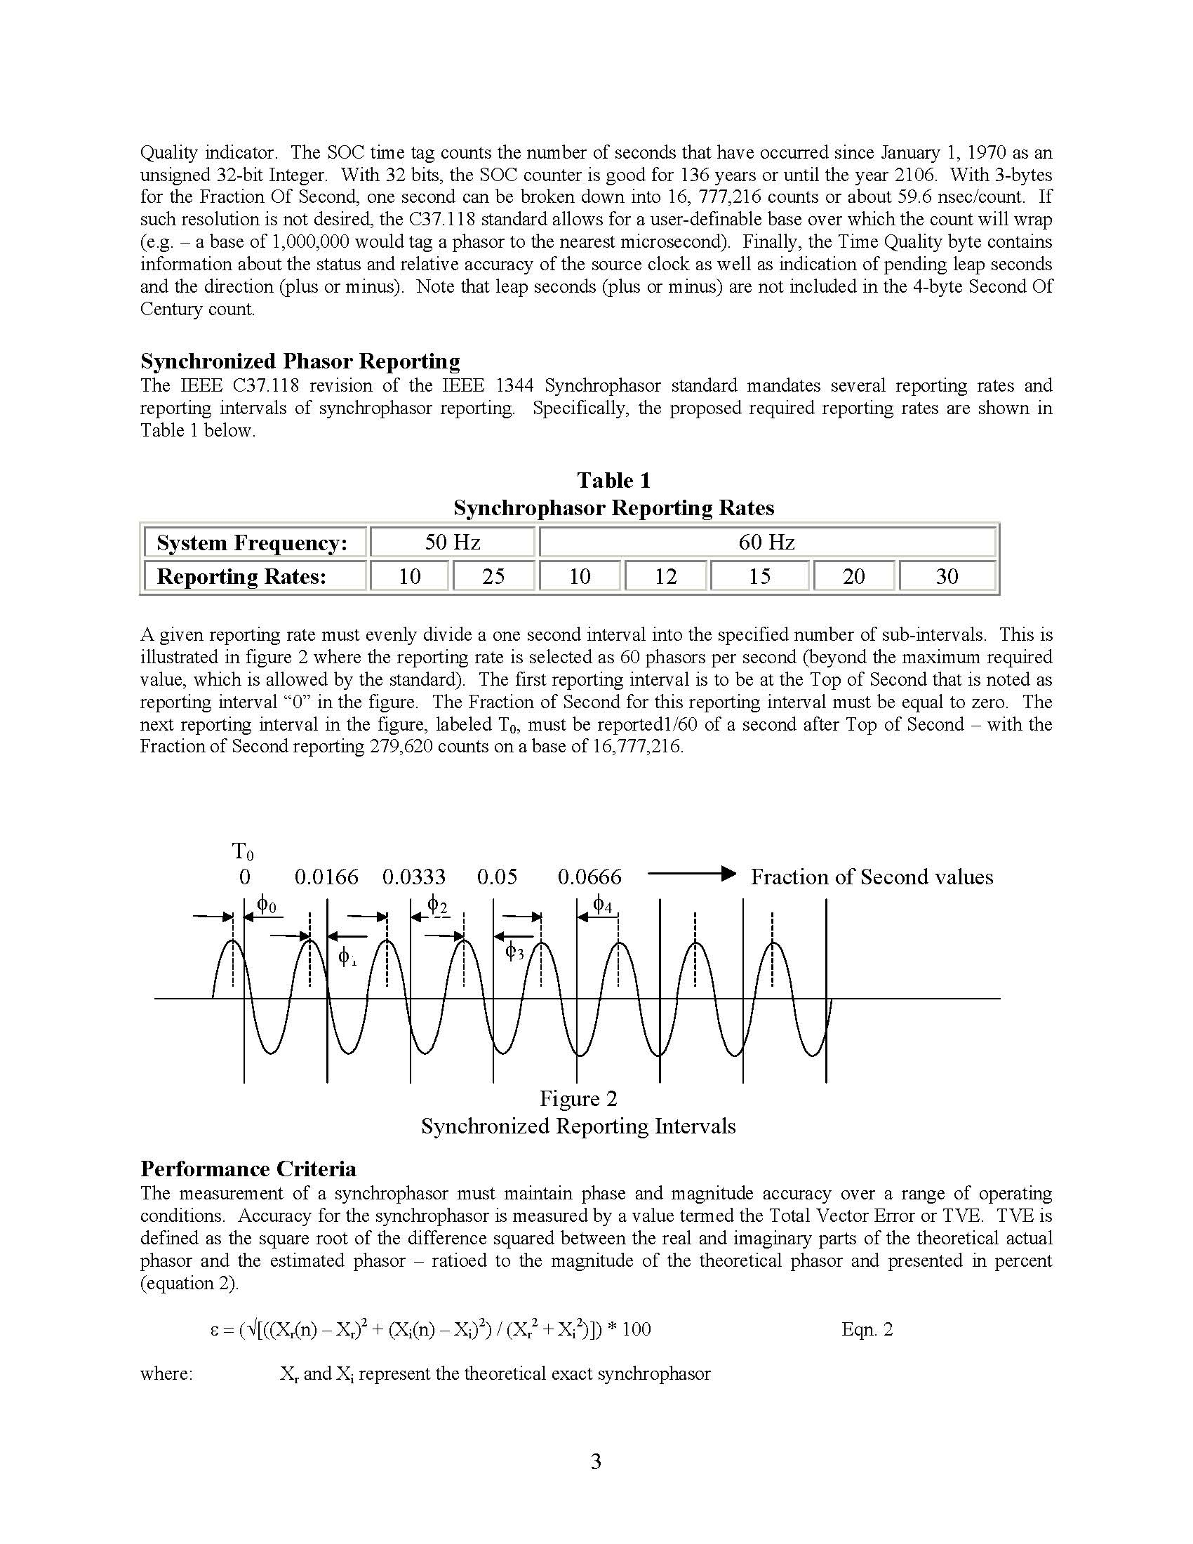
Synchrophasor Data Collection
A.G. Phadke, "Synchronized phasor measurements-a historical overview," IEEE Transmission and Distribution Conference and Exhibition, volume 1, pages 476-479, 2002.
J. Sykes, K. Koellner, W. Premerlani, B. Kasztenny, and M. Adamiak, "Synchrophasors: A Primer and Practical Applications," IEEE Power Systems Conference: Advanced Metering, Protection, Control, Communication, and Distributed Resources, 2007.

Slide 4
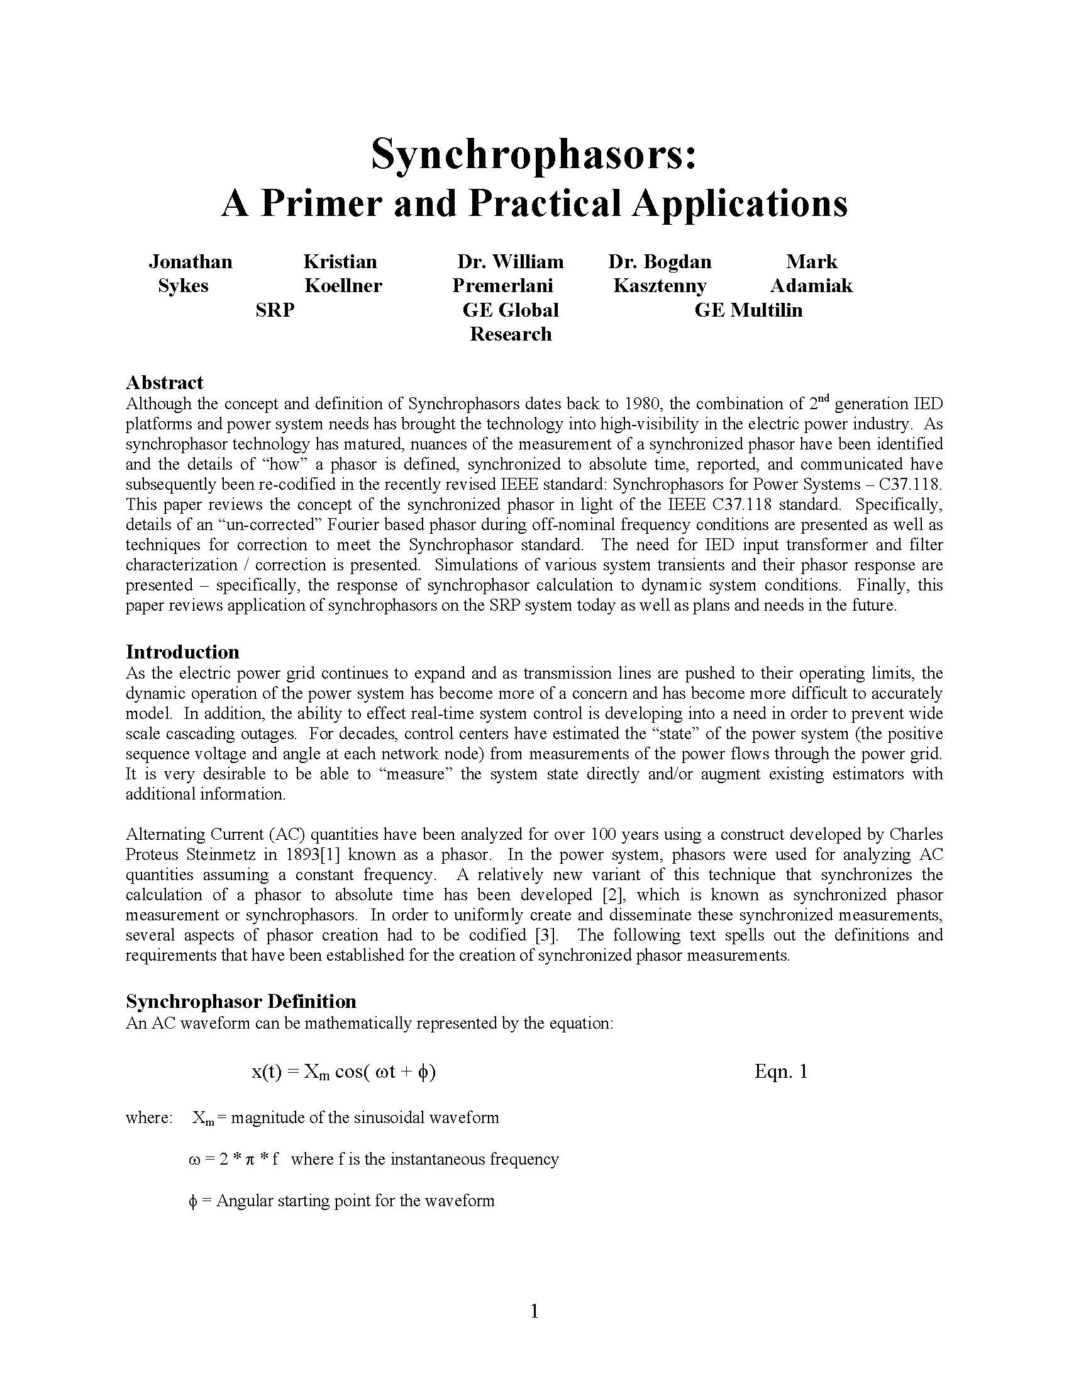
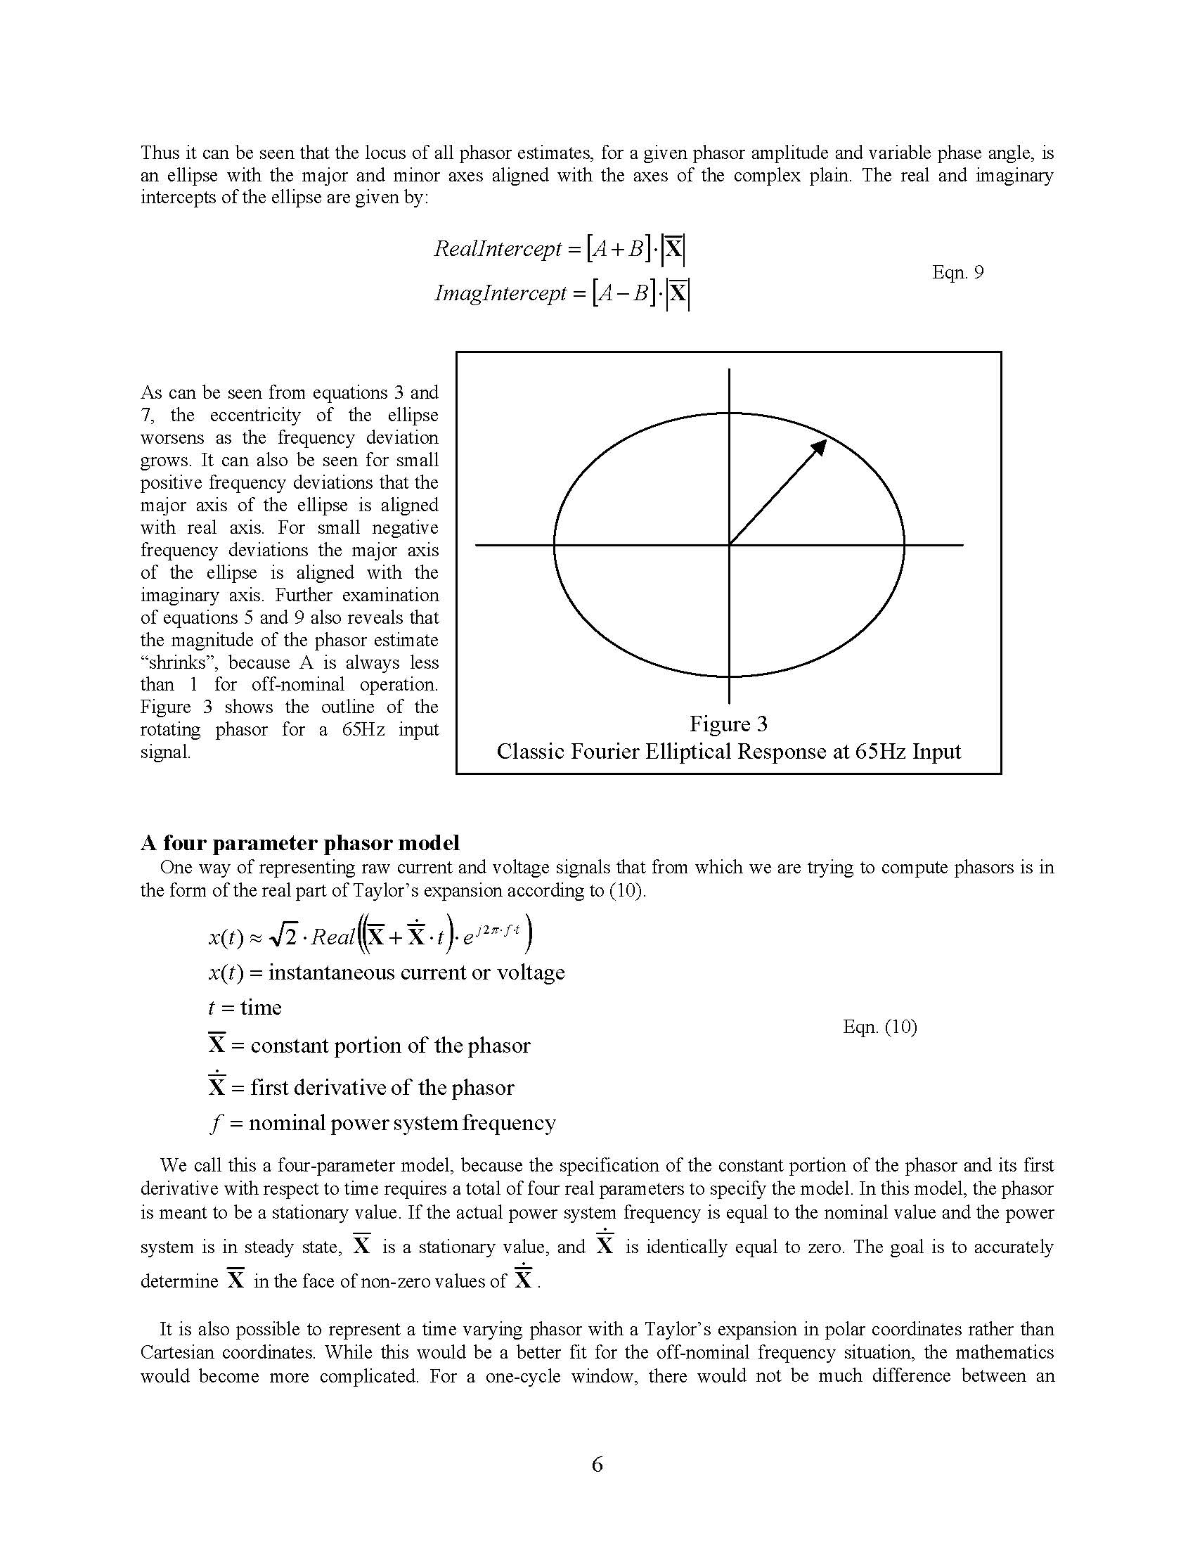
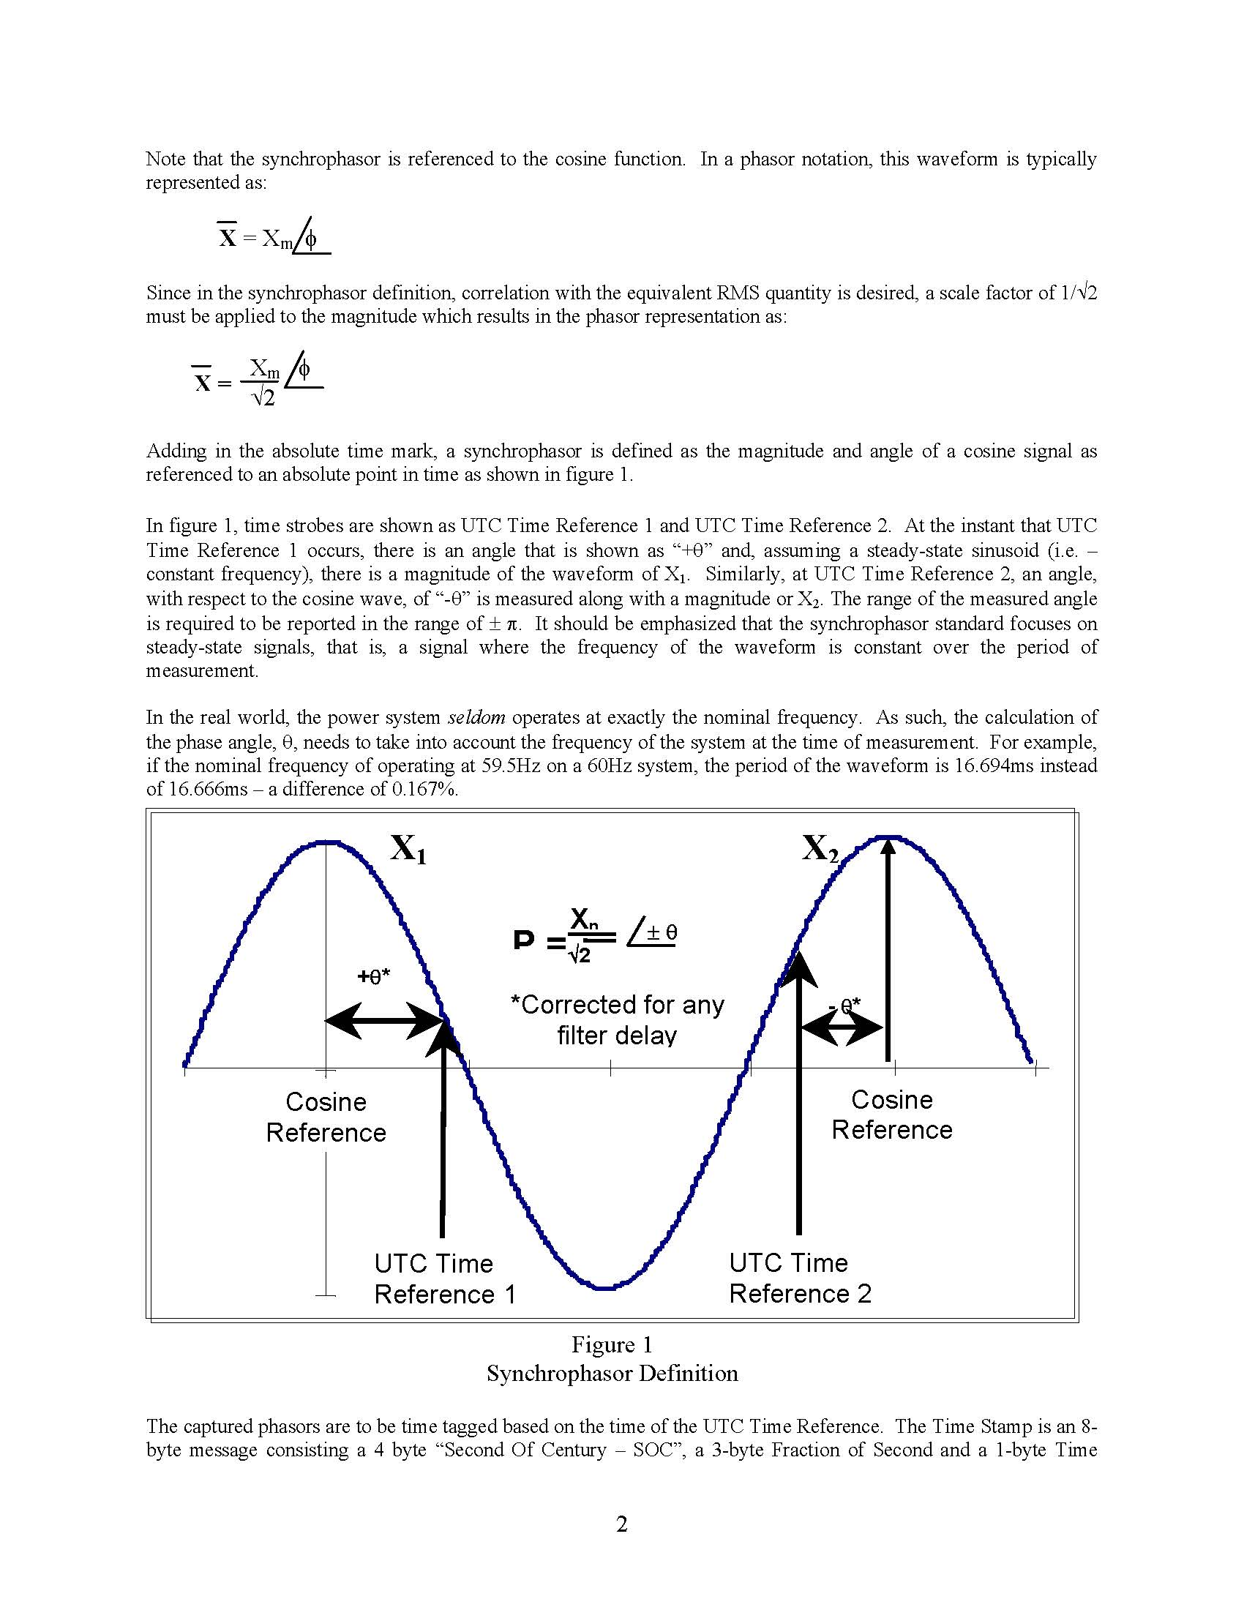
Synchrophasor Representation
Time signal and phasor
Four parameter representation, based on Taylor series expansion
J. Sykes, K. Koellner, W. Premerlani, B. Kasztenny, and M. Adamiak, "Synchrophasors: A Primer and Practical Applications," IEEE Power Systems Conference: Advanced Metering, Protection, Control, Communication, and Distributed Resources, 2007.

Slide 5
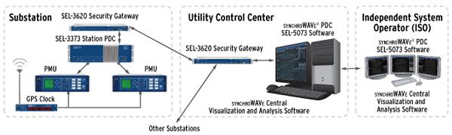
Basic Components of a Synchrophasor System
GPS clock
Phasor measurement unit (PMU)
Phasor data concentrator (PDC)
Communication
Visualization software
www.selinc.com

Slide 6
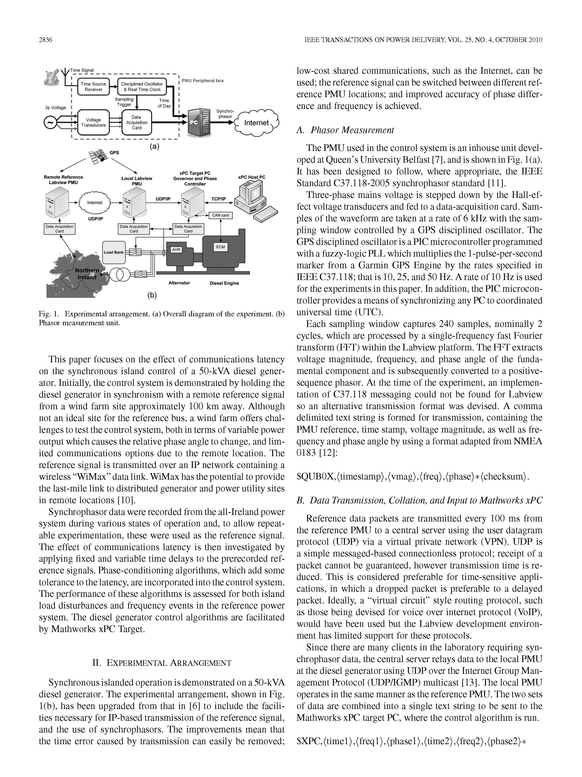
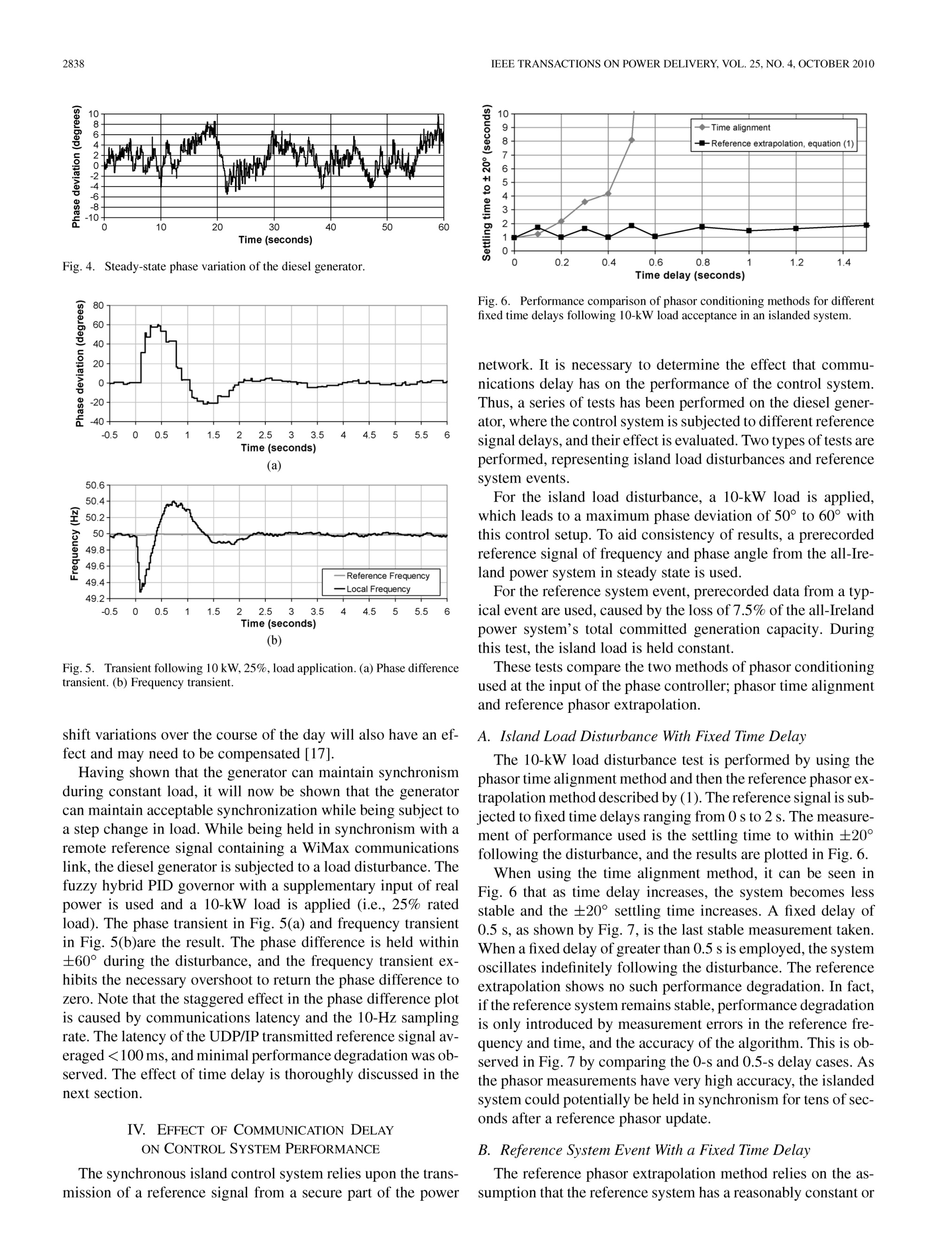
Application to Generator Control
R.J. Best, D.J. Morrow, D.M. Laverty, and P.A. Crossley, "Synchrophasor Broadcast Over Internet Protocol for Distributed Generator Synchronization," IEEE Transactions on Power Delivery, volume 25, number 4, pages 2835-2841, 2010.

